Slide 1


Taking pride in learning
Name
Homeroom
Teacher
If found, please return to:
Namao School
2-24400 Hwy 37
Sturgeon County, AB
T8T 0E9
(780) 973-9191

Slide 2

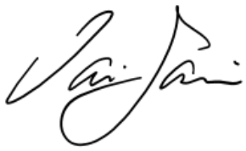
Principal’s Message
Welcome to a brand-new school year! Whether you're returning or joining us for the first time, we’re so glad to have you as part of our school community. The start of the year brings new possibilities, fresh goals, and the chance to grow both inside and outside the classroom.
To our returning students—welcome back! Your spirit, creativity, and curiosity bring our school to life, and we’re excited to see all the ways you’ll shine this year. To our new students and families—welcome! We’re thrilled you’re here and are committed to helping you feel connected, supported, and valued from day one.
A heartfelt thank-you goes to our parents and guardians. Your ongoing support and trust mean the world to us. Together, we can make this year one of meaningful learning, positive relationships, and shared success.
As we move forward, let’s lead with kindness, show respect, and create an environment where everyone feels they belong. Here’s to a year of discovery, connection, and memorable moments!
Principal Iain Jamieson
Guiding Principles
A strong partnership between parents, staff, and students is essential in assuring each student meets their potential, enabling Namao School to be the best possible. As a Learning Community, we believe we should be committed to providing quality instruction with a prime focus on student learning.
Namao School staff, students and families share responsibility in being proactive in maintaining a welcoming, caring, respectful, safe and inclusive learning environment that acknowledges and promotes understanding, respect and the recognition of diversity, equity, inclusion and human rights of all students and families within the school community. (Per Policy 310 & Education Act - Sections 16, 35, 35.1)
Namao School is committed to:
Providing excellent instructional programs and educational opportunities.
Establishing and nurturing a relevant, interactive, flexible, safe & caring learning environment.
Encouraging varied, creative and critical thinking.
Facilitating a climate of mutual respect through enthusiastic modelling.
Providing a productive learning environment through organizing classes that are reasonable in size and composition and allocating resources fairly.

Slide 3
Bell Schedule
The school doors open at 8:25 AM. If you are dropping off your child prior to 8:25 AM, we ask that they wait outside until the doors open.
For the safety of our students, if the weather is inclement and buses are not running, please ensure that your children have entered the school prior to leaving the premises.
Thank you for your cooperation!
8:00 am | Operational Day Begins
8:25 am – 8:35 am | Bus Unloading (Door Supervision)
8:35 am – 8:40 am | Attendance and Announcements
8:40 am – 9:40 am | Block 1
9:40 am – 10:40 am | Block 2
10:40 am – 10:55 am | Morning Recess
10:55 am – 11:55 pm | Block 3
11:55 pm – 12:20 pm | Noon Recess
12:20 pm – 12:40 pm | Lunch
12:40 pm – 1:00 pm | Block 4 - Advisory
1:00 pm – 2:00 pm | Block 5
2:00 pm – 3:00 pm | Block 6
3:00 pm – 3:10 pm | Dismissal and Bus Loading
4:00 pm | Operational Day Ends
Dress Code
Students require non-marking footwear.
Students require indoor and outdoor shoes.
Clothing may not have indecent images or profanity.
Hats in the classroom are up to individual teacher discretion.
Students should dress appropriately to the environment and activity they are participating in.

Slide 4
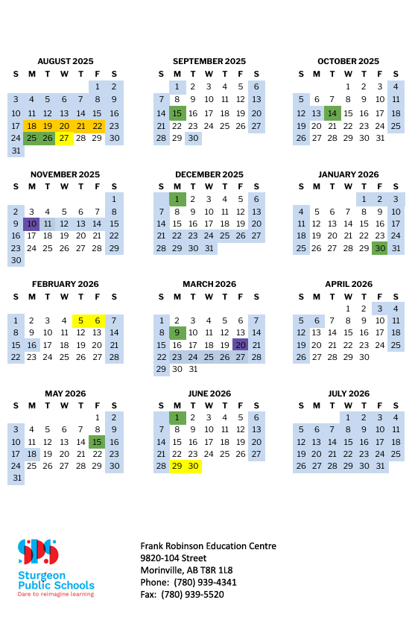
School Year Calendar 2025-2026

Slide 5
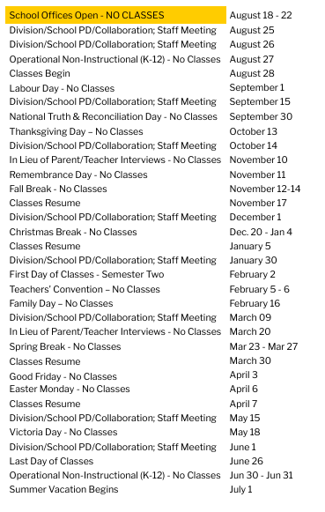

Slide 6
PowerSchool and Fees
PowerSchool Parent Portal
Please use Parent Portal to digitally track your child’s progress, attendance, sign permission forms and pay your school/bus fees online.
Parents of returning students can access their child’s account through their existing PowerSchool Parent Portal account. New students must first be registered at their school, to have a Parent Portal account created.
If you require access or have questions regarding the use of PowerSchool Parent Portal, don’t hesitate to contact the school office at 780-973-9191.
Fees and Online Payment
Fees
Students are charged fees depending upon program requirements, courses, extra-curricular activities, field trips and athletic team selection. Fees are charged with the intent to enhance student education and provide opportunity.
Fees are communicated at the start of school year, at the start of each term, and as field trips and activities are planned throughout the year.
Fees may change from year to year and between activities, you are encouraged to contact the school directly for details.
Online Payments
Fees are posted to your child’s account in PowerSchool and can be paid online. Account statements are emailed to parents/guardians regularly. All fees for students are due upon receival of notification and/or statement.
Students with outstanding fees may be ineligible to participate in extracurricular activities such as field trips, athletic team participation and/or Grade 9 Prom exercises. Outstanding fees may also lead to changes in option programming choices for junior high students. Non-payment of fees will be forwarded to Corporate Services.
If you cannot make payment, please get in touch with the school to make alternate arrangements.
Note: The PowerSchool Mobile app does not offer secure payment processing. PowerSchool must be accessed on a web browser in order to make payments.
Fees for students who are absent or withdraw will be assessed on a case-by-case basis.

Slide 7
Absences & Transportation
Report an Absence
Please remember to report your child’s absence. Email namao@sturgeon.ab.ca or call the office at 780-973-9191. We use an automated system with our attendance here at Namao School. Children must understand the importance of being in their classroom for attendance or check-in at the office if they arrive late to class. If your child is ill, please let us know if it is respiratory, gastrointestinal or a rash.
School Calendar
This calendar is updated in real-time as staff enter events. Please check our calendar for the most up-to-date events.
Replacement Bus Pass
If your child loses or misplaces their bus pass, please complete the Replacement Bus Pass form.
Inclement Weather
Policy 320: Inclement Weather
The Board believes that the responsibility of the safety of school bus passengers during periods of inclement weather or hazardous road conditions is shared by the Board, its staff, school bus operators and by parent/guardians.
The final decision to send a child to the bus stop or to school rests with the parents/guardians, even though buses and schools may be operational.
School bus service may be suspended at a temperature of minus forty (40) degrees Celsius, as determined by the Weather Network at Bon Accord, AB.
When buses are running on extremely cold days, we assemble students in the community entrance if their bus is arriving late or picks up late to ensure they are not standing in the cold.
We always watch the temperature very closely and review road conditions and weather conditions. The -40*C does not include wind chill.
Our school is always open to receive students
Code of Conduct
Namao School promotes, reinforces and encourages the growth of self-discipline, respect and responsible behaviour to foster a safe and caring learning environment.
Philosophy
The underlying philosophy of Namao School is that all students have the right to learn in a positive environment. A positive learning environment is one in which students are encouraged to make appropriate choices and are responsible for their behaviour. There are logical and natural consequences for the choices a student makes. Our goal is to work with parents and students in understanding how to make positive choices and encouraging students to make positive ones where the needs of each student are respected. We know that students are learning the skills necessary for successful problem-solving. Identifying problems, understanding expectations, taking responsibility for one's actions, and making positive choices are essential to student growth and learning.
Developing positive behaviour (ethical citizens) is a shared responsibility between students, staff and parents.

Slide 8
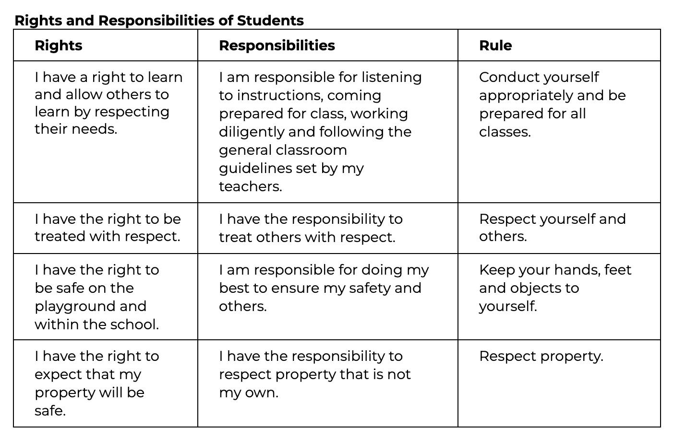
Restorative Measures
When students choose not to follow the expectations, various interventions will occur. Classroom teachers will deal with situations that arise with their students, promoting positive choices. Some issues will only require talking to students to find ways to resolve the issue. When issues are concerning, teachers will call parents to seek their assistance in stopping the concerning behaviour. If an issue is serious, students may need to speak with the school administration. Parents may be contacted depending on the event's seriousness and informed of the issue and the possible consequences.
Where appropriate, stakeholder meetings will encourage restorative resolutions considering each stakeholder's concern. Students will need to develop a plan to become responsible for their actions. A range of consequences will be collaboratively determined when the students identify the challenge, the benefits of following the expectations and their responsibilities to improve the situation. These consequences may include apologies, loss of privileges, community service and suspensions.
Acts of physical aggression or violence, cyber-bullying and illegal substances will not be tolerated and will be met with serious consequences. *Per Board Policy 120 - Harassment Policy
Responsibilities of Staff
Our staff establishes a positive school climate in which structure, support and encouragement are provided to assist in understanding the importance of education and developing a sense of self-awareness and responsibility while positively contributing to society.
Namao staff will ensure that:
They build positive and productive relationships with students, parents/guardians, peers and others in the school and the local community to support student learning.
They establish, promote and sustain inclusive learning environments where diversity is embraced, and every student is welcomed, cared for, respected and safe.

Slide 9
Students and staff have the right to learn and work in an environment that respects diversity and promotes equity, inclusion and human rights.
Appropriate behaviour is consistently modelled, encouraged and complimented, thus increasing student self-esteem and reinforcing positive behaviours.
Ongoing communication exists between staff and parents to encourage and provide the opportunity for active and constructive parental involvement in their children's education.
Responsibilities of Parents
Parents ensure their children are ready to learn and help them to make positive and consistent progress toward their academic goals.
The role of the parent with respect to education includes the following:
Establish a positive learning atmosphere in the home
Support the staff in assisting your child in understanding, respecting and following school expectations.
Support your child by being actively involved.
Maintaining communication with staff regarding your child’s academic and social progress
Encourage and support the regular and punctual attendance of your child.
Keep the staff apprised of necessary emergency information and ensure the school has emergency contact phone numbers so parents can be reached when needed.
Avoidable Extended Absences During the School Year
Sturgeon Public Schools believes regular school attendance is a significant contributing factor to student learning, positive connections at school, and student progress.
Parents/guardians sometimes choose to take students out of school for extended periods for vacations, hunting, working at a place of employment, or other unavoidable reasons. In these situations, the school may not excuse these absences but mark them as “parent aware.” Regular class attendance is essential for maximizing achievement.
In addition, Namao School cannot reschedule PAT exams for these avoidable extended absences. If an avoidable extended absence is scheduled during the school year, The parent/guardian should inform the administration and the various subject teachers well before the event. The student will be responsible for obtaining notes and completing assignments during their absence. *Per AP905 - Student Attendance at School
After discussing extended absences with their teachers, students may find this information via classmates, Google Classroom/SeeSaw or other means. The teacher may not provide homework packages before or during the extended absence.
Upon returning, the student must complete and turn in any required assignments and complete assessments within a reasonable amount of time, determined by the teacher.

Slide 10
Volunteering
We appreciate our volunteers. If you wish to volunteer in the school, you must supply a current criminal record check, as well as a submitted Volunteer Guidelines and Confidentiality Agreement through PowerSchool’s Parent Portal. Certain activities may also require a vulnerable sector check.
If you are volunteering for the school, please ensure that you have arranged this with a staff member ahead of time, that you check in with the office, and that you are working in a prearranged space. This is to respect the safety and privacy of our students.
Personal Device Policy
At Namao, we strive to create a supportive and nurturing learning environment that encourages positive social interactions and fosters academic excellence. We ask students not to use devices (e.g., cellphone, smart watches, etc.) that impact academic learning throughout the day to achieve these goals.
Students must store their devices in their lockers for the entire school day. This includes both breaks.
Students must have a lock on their locker to ensure their device is safe.
Per the Technology Use Agreement, the school is not responsible for the loss of personal items.
Research has shown that excessive use of technology can lead to decreased social skills, poor academic performance, and mental health issues (Twenge, Campbell, & Martin, 2018). In contrast, limiting screen time can improve social connections, academic skills, and overall mental health (Grand Canyon University, 2018). Limiting use during socialization (e.g., recess) can improve face-to-face communication and strengthen social bonds (Grand Canyon University, 2018).
By eliminating the use of devices unrelated to academic use during school hours, we hope to cultivate a more positive and supportive school community while promoting healthier habits and enhancing academic performance (Lepp et al., 2015). We appreciate your cooperation in creating a better learning environment for all.
If your device is not stored in your locker during school hours, including break periods, a parent or guardian must retrieve it from the school office. This is necessary to ensure a safe and focused learning environment for all students.
References
Grand Canyon University. (2018, May 8). How Cellphones Affect Communication Skills. [Blog post]. Retrieved from https://www.gcu.edu/blog/gcu-experience/how-cellphones-affect-communication-skills
Lepp, A., Barkley, J. E., & Karpinski, A. C. (2015). The relationship between cell phone use, academic performance, anxiety, and satisfaction with life in college students. Computers in Human Behavior, 43, 210-217. https://doi.org/10.1016/j.chb.2014.10.053
Twenge, J. M., Campbell, W. K., & Martin, G. N. (2018). Decreases in psychological well-being among American adolescents after 2012 and links to screen time during the rise of smartphone technology. Emotion, 18(6), 765-780. https://doi.org/10.1037/emo0000403
Rosen, L. D., Carrier, L. M., & Cheever, N. A. (2013). Facebook and texting made me do it: Media-induced task-switching while studying. Computers in Human Behavior, 29(3), 948-958. https://doi.org/10.1016/j.chb.2012.12.001
Sturgeon Public School Division. (2021). 870: Exhibit 2: Technology Resources Responsible Use Protocol Students

Slide 11
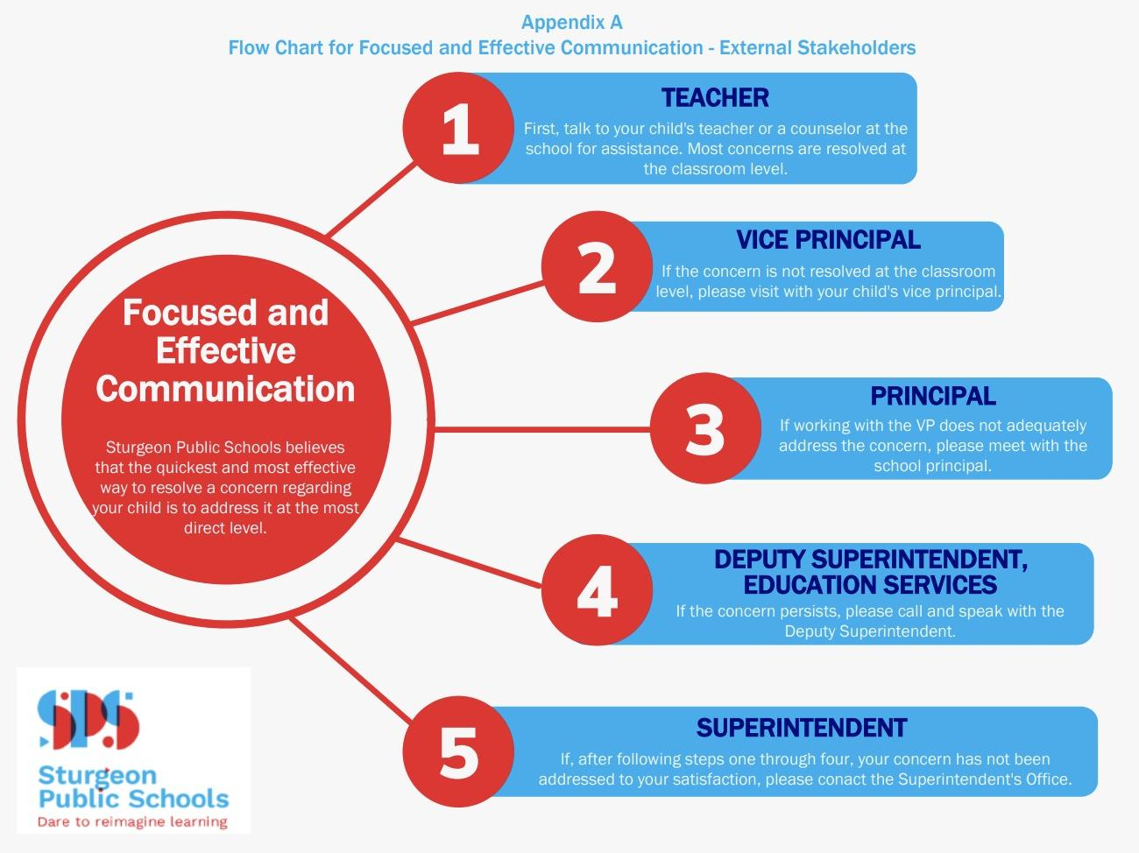
Focused & Effective Communication
Focused and Effective Communication is an interest-based dispute resolution approach for dealing with communication and challenges between internal and external stakeholders. Sturgeon Public Schools reviewed AP717 – Healthy Interactions Program and replaced it with a new Administrative Procedure - AP221 - Focused and Effective Communication. AP221 clearly defines the process for open communication and dispute resolution in Sturgeon Public Schools.
At Namao, we cultivate healthy relationships when problem-solving. Nurturing healthy relationships by considering stakeholder interests and a problem-solving approach to conflict resolution creates and maintains open lines of communication. It meets the needs of staff, parents, students and the community through building stronger relationships. Building healthy relationships is an ongoing process in which all parties commit to making relationships work—a winning approach for staff, parents, community, and especially students. Concerns regarding your child start with the teacher first.
We intend to assist staff, parents and community members to more effectively and efficiently resolve potentially difficult issues while minimizing unproductive conflict. Therefore, all possible participants must understand that in Sturgeon Public School Division, there is one standard and consistent manner in which concerns, problems and issues will be handled.
Consistency: All Sturgeon Public School employees follow consistent procedures and use consistent terminology—people know what to expect.
Comprehensiveness: The interests of all parties involved (parent, staff, student, others) will be considered whenever a concern arises—no one is ignored.
Credibility: All individuals in a community must know that all concerns are handled in an interest-based manner that is fair to everyone.

Slide 12

Colouring Pages

Slide 13


